Slide 1
Cross Functional Team (CFT) Meeting Executive Secretariat SWIFT Digital Mail Solution March 30, 2021
Enterprise Architecture
OCIO Policy, Strategy and Planning (PSP) division

Slide 2
Overview
Mails are physically distributed by PSC to Exec Sec and all program offices throughout ACF. The process is as follows:
Program Support Center (PSC) staff physically scan the mails
Scanned mails are sent to computers
Scanned mails are uploaded from computers to the SWIFT system for processing (SWIFT is used to manage executive correspondence for ACF and other tenant agencies); or
Mails are physically delivered to the appropriate office(s) (walking it from floor to floor, as needed).
The current process has resulted in:
Mail displacements
Lost mails
Delays in mail delivery
Delays in ACF staff responses to direct inquiries

Slide 3
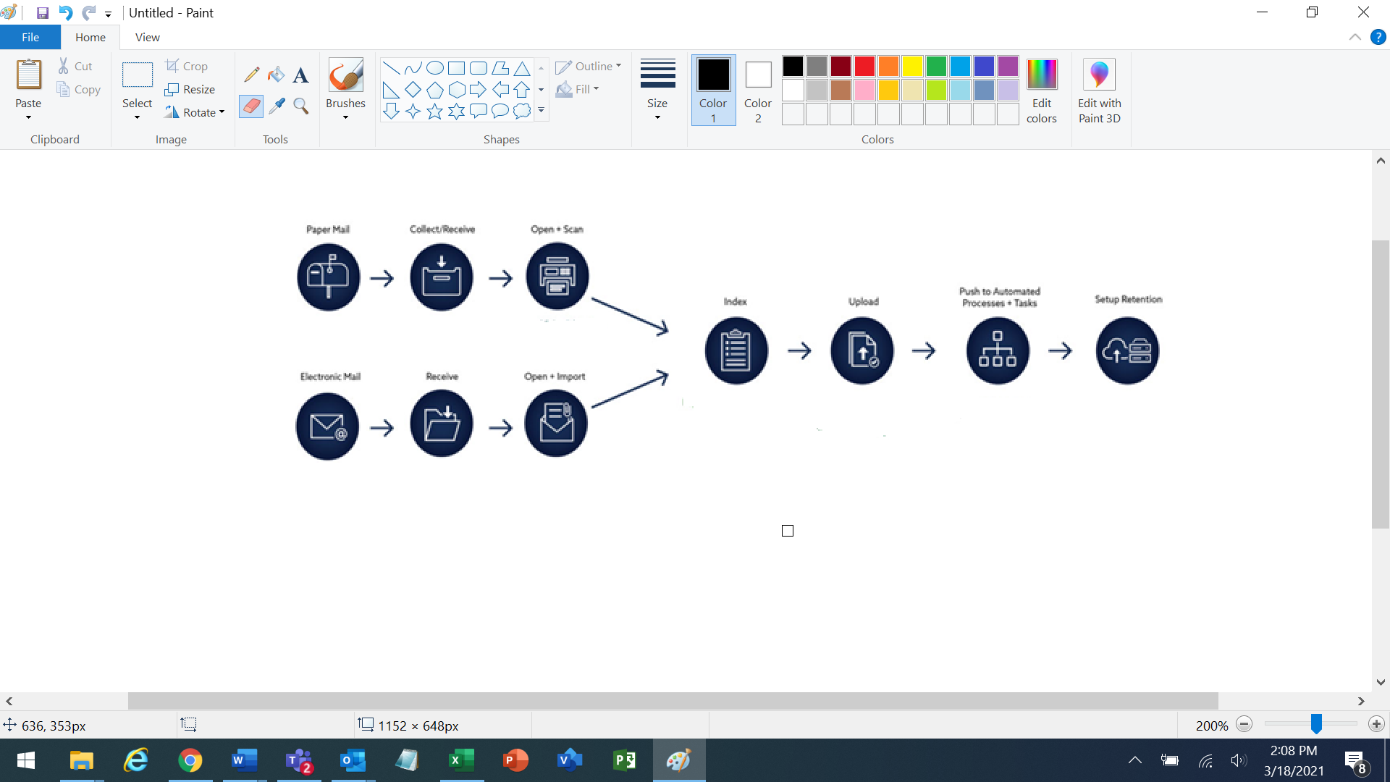
Business Requirements
Exec Sec is requesting OCIO to identify a solution that would automate and deliver mail electronically from the point of entry to HHS/ACF. The solution is called Digital Mail. Digital mail is a hybrid mail and scanning process that coverts incoming paper mail into digital and delivers the mail to the addressee electronically and / or physically.
The basic To-Be process for a Digital Mail Solution is shown below:

Slide 4
Cost and Benefits
Cost & Constraints
Agreement from and coordination with PSC
Research, selection and purchase of a feasible solution
Deployment of the solution
Integration with SWIFT
Staff Training
O&M
Benefits
Efficient processing of incoming mails
Timely delivery and redirection of mails to all program offices
Minimizing / eliminating lost or misplaced mails
Minimizing / eliminating labor intensive processes
Streamlined integration with SWIFT
Improved search capability
Timely responses by program offices to constituents

Slide 5
Backup

Slide 6
Digital Mail Solutions
DOMA Technology: Digital Mailroom
https://www.domaonline.com/digital-mailroom/
Pitney Bowes: Digital Mail Center
https://www.pitneybowes.com/us/shipping-and-mailing/case-studies/digital-mailroom-future-of-mail-automation.html
Exela: Digital Mailroom
https://exela.digitalnow.com/digital-mailroom-features/

